Slide 1

Alpha Anywhere Q&A
March 23, 2022

Slide 2


Slide 3

Register at www.alphasoftware.com/devcon2022

Slide 4

Cordova CLI
Introduction to building Android apps with Cordova CLI

Slide 5
What is Cordova CLI?
A Command Line Interface (CLI) for building mobile applications using the Apache Cordova framework.
Apache Cordova is a framework for building native mobile applications for Android and iOS.
Apps built using HTML, CSS, and JavaScript
Build your app once. Deploy to multiple platforms.

Slide 6
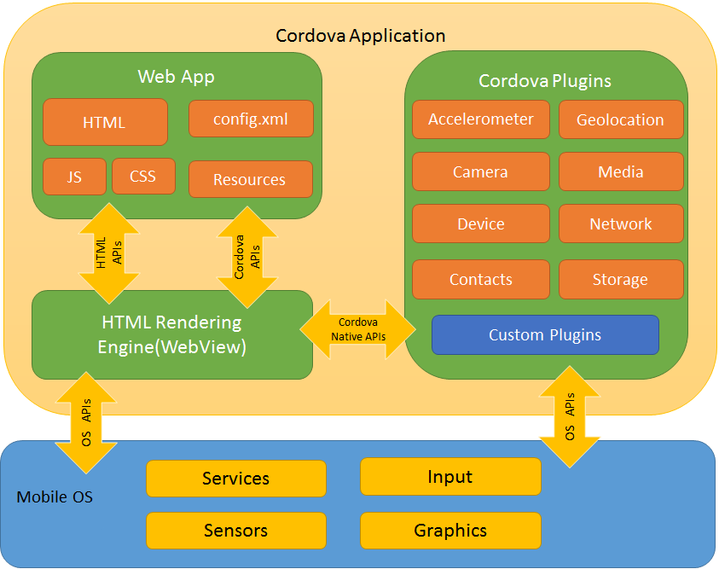

Apache Cordova
Alpha Anywhere

Slide 7
Tools for building Android Apps on Windows
Java Development Kit (JDK)
Gradle
Git
Node.js
Cordova
Android Studio

Slide 8

NEW in the next Alpha Anywhere Release
Cordova CLI 11.x.x support
Android API level 22 - 30
Upgrading:
npm uninstall -g cordova
npm install -g cordova@11.0.0

Slide 9
How to Upgrade Other Tools
System Variables
JAVA_HOME - Location of the JDK installation
ANDROID_SDK_ROOT - Location of the Android SDK installation
System PATH
Add JDK bin, Android platform-tools, and Gradle bin

Slide 10
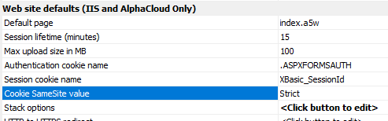
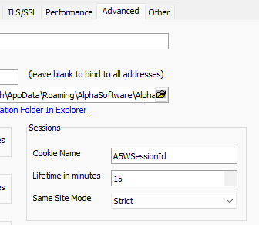
Configure the Server SameSite Value
Set Server SameSite value to Unset
Alpha Cloud, IIS
Web Project Properties > Web site defaults > Cookie SameSite value
Classic Server
Server Settings > Advanced > Same Site Mode

Slide 11
Publish your App to the Server
Required if your app makes any callbacks to the server
Get the Ajax Callback URL

Slide 12

Create a Cordova Project
Set App Build Target: CLI
Configure remaining options for your application

Slide 13

Today
Configuring the Development Server for Local Testing
Ajax Callback URL - What is it
Testing on an Emulator
Testing on a Device

Slide 14

To the Live Demo

